Slide 1


Modeling and Simulation of the Shape and Interior Pressure of Enveloped Viruses:
Motivated by Orthopoxviruses and Coronaviruses
Hua Deng
Advisor: Professor Chwen-Yang Shew
Doctoral Chemistry Program, Department of Chemistry
College of Staten Island, Staten Island, NY 10314

Slide 2
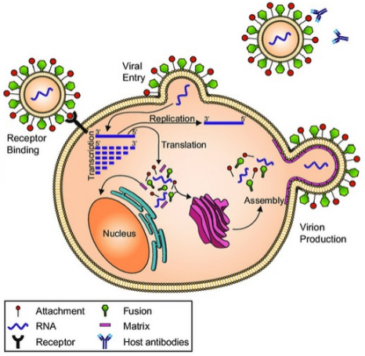
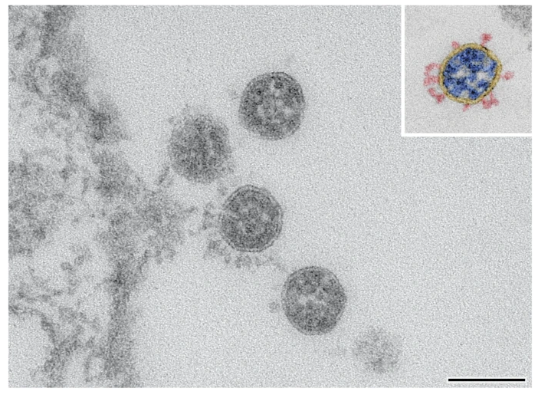
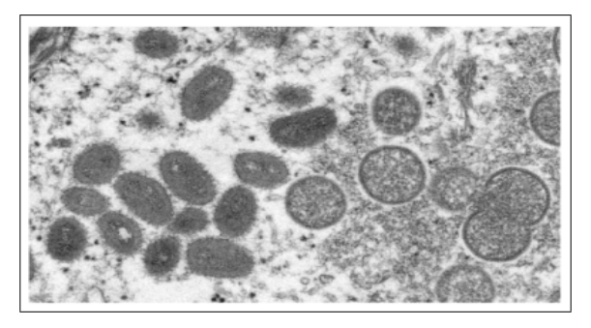
Introduction
SARS-CoV-2 particles
Monkeypox virus particles
Diagram of the viral life cycle.
Notes:
Viral infections significantly impact global health, driving pandemics and outbreaks. Enveloped
viruses like Monkeypox and COVID-19 are surrounded by lipid membranes that protect their genomes
and enable infection by interacting with host cell receptors. Understanding these mechanisms is key to
developing effective treatments.
Virions are acellular particles lacking cellular structures such as organelles.

Slide 3
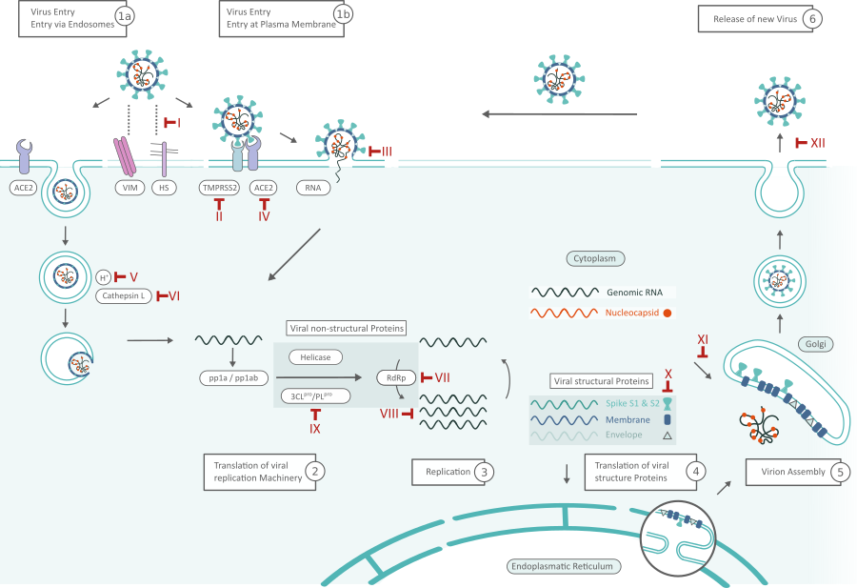
Introduction
Notes:
This diagram shows the full life cycle of an enveloped RNA virus, such as SARS-CoV-2, inside a host cell, from entry to release of new virus particles.
The process begins when the virus binds to receptors on the cell surface, and enters the cell either through endocytosis or by fusing directly with the plasma membrane. Once inside, the viral membrane opens and releases RNA genome into the cytoplasm. Because the genome is positive-sense RNA, it can be translated immediately by host ribosomes to produce viral enzymes that form the replication machinery. These enzymes then copy the viral RNA, generating both new genomes and shorter RNAs used to make structural proteins. The structural proteins are produced in the endoplasmic reticulum and transported through the Golgi apparatus, where they assemble together with the viral RNA to form new virus particles. Finally, the newly assembled virions are packaged into vesicles and released from the cell, allowing them to infect neighboring cells and continue the infection cycle.

Slide 4
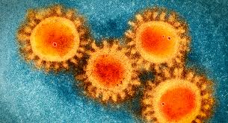
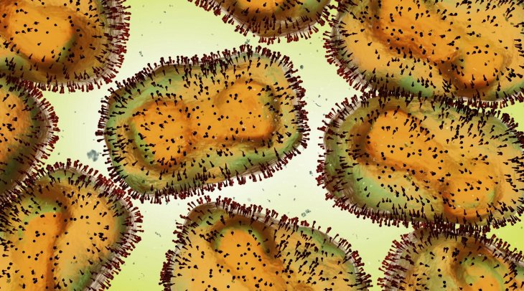
Introduction
Figure 1 Coronaviruses. Colorized transmission electron micrograph (TEM) of SARS-CoV-2, the coronavirus that causes COVID-19. The round particles with a fuzzy outer edge show the spike (S) glycoproteins projecting from the viral envelope.
Figure 2 Orthopoxviruses. Colorized transmission electron micrograph highlighting the brick-shaped morphology and surface structures of mature virions; colors are artificially added for clarity.
Figure 3. Four SARS-CoV-2 particles imaged by transmission electron microscopy at 135,000x magnification, positioned near the Vero cell surface on the left. The inset displays a color-coded particle with spikes in red, the viral membrane in yellow, and the ribonucleoprotein in blue. Scale bar = 100 nm.[22]
Figure 4. Electron microscopic (EM) image for Monkeypox virus particles. Oval-shaped virus particles are mature, and spherical particles are immature virions.[6]

Slide 5
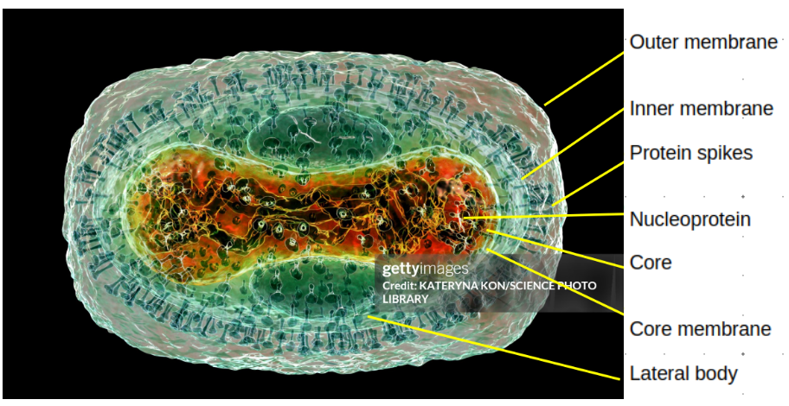
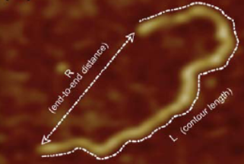
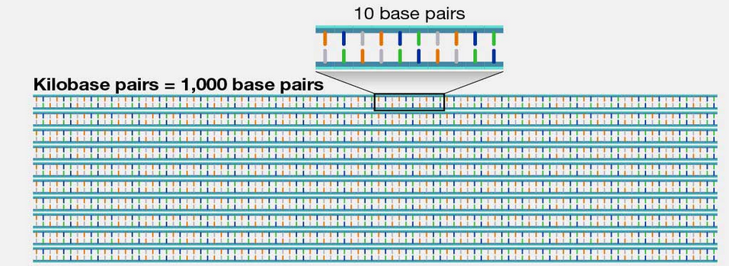
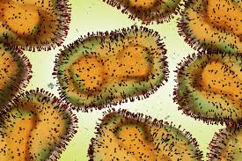
Introduction
Figure 7. A kilobase (abbreviated kb) is a unit of measurement used to help designate the length of DNA or RNA. One kilobase is equal to 1,000 bases.
Figure 5 Determination of the contour length and the end-to-end distance for an isolated DNA. [23]
Figure 6 Monkeypox virus particle, Illustration
Figure 8 Orthopoxviruses
Figure 9 Coronaviruses
Notes:
In terms of genomes, Orthopoxviruses are DNA viruses containing about 200 kilobase pairs of double-stranded DNA on average, forming a rigid, elongated dumbbell morphology with a contour size of about 250 nm in length and 200 nm in width. Coronaviruses,by contrast, are single-stranded RNA viruses with around 30 kilobase pairs and an average contour size of 50–140 nm. A general feature among these viruses is that their genomes are highly confined and crowded insidethe capsid. As a result, they may exhibit internal pressures ranging between 10–60 atm to facilitate genome injection into the host cell’s nucleus.

Slide 6
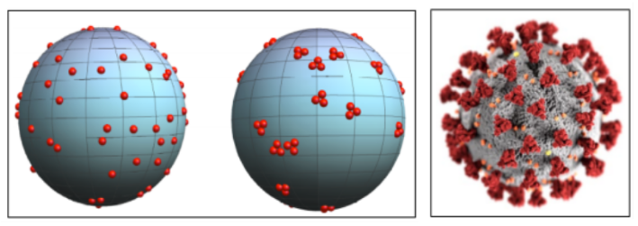
Motivation from previous Coarse-Grained Modeling and Monte Carlo simulation
Left image: Simulation of the SARS-CoV-2 spike protein on a spherical surface, illustrating the progression from randomly distributed monomers (Left) to trimer (Right) formations. Right image: SARS-CoV-2 for Covid-19 schematic image (CDC Public Health Image Library)
Notes:
Previously, we studied how individual particles on a spherical surface can come together to form groups of three, inspired by the trimer structure of spike proteins in COVID-19 viruses. Using Monte Carlo simulations, we showed that when particles experience both directional attraction and short-range repulsion, forming trimers becomes energetically favorable. We found that the strength and form of the interaction are important to overcome the natural tendency of particles to form simpler pairs. By changing the directionality of the attraction, larger groups such as tetramers can also become dominant. The structures formed in the simulations agree well with experimental cryo-electron microscopy images of SARS-CoV-2 spike proteins.
Building on this work, we now aim to develop a simple coarse-grained model with only a few key parameters to understand how the membrane and the enclosed genome work together to determine the shape of enveloped viruses. This approach focuses on large-scale physical behavior rather than molecular details and is intended to provide insight into how viral components are organized inside the particle, how the genome influences the membrane, and how internal pressure arises from the packed genetic material. These physical insights may help guide future antiviral strategies.

Slide 7
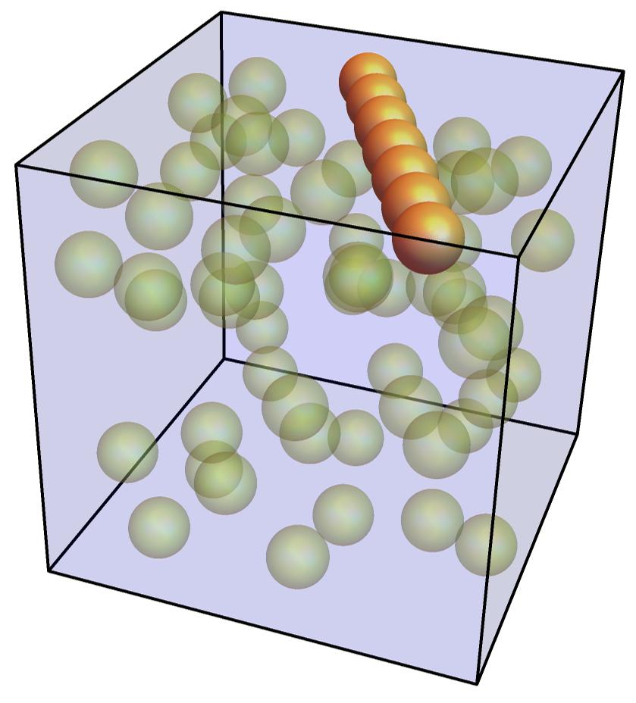
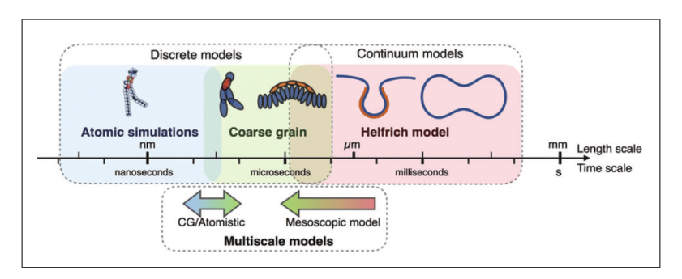
Modeling Approach
Coarse-Grained Models (CGM):
It simplifies complex systems by grouping atoms or molecules into larger particles called beads. This allows for large-scale simulations at low computational cost and supports the identification of minimal-parameter models.
Figure 9 Different computational methods developed to study membrane and genome are valid in different length and time scales.
Figure 10 Model of DNA/RNA (Orange Rod) and Organelles (Green Spheres) Confined in a Membrane (Rectangular Prism)
Notes:
We use a coarse-grained model simulated by the Monte Carlo method.
Combine many atoms into one bead to:
Reduce complexity
Run much faster simulations
Study large systems (genomes, membranes, polymers)
This figure shows how scientists use different types of models to study the same system at different sizes and time scales. At very small scales, atomistic simulations describe every atom in detail, which gives accurate information but can only be used for tiny systems and very short times. At a larger scale, coarse-grained models simplify the system by grouping many atoms together, making it possible to study bigger structures and longer processes while keeping the main physical behavior. At the largest scale, continuum models treat the system as a smooth shape instead of individual particles, which is useful for understanding overall form and bending. By combining these approaches, researchers can choose the simplest model that still captures the important physics of the problem.

Slide 8
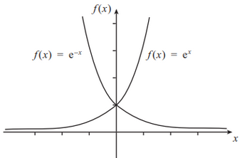
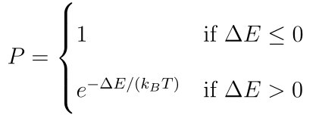
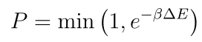
Simulation method
Monte Carlo Simulations: Using random sampling to solve math and physics problems
The Metropolis acceptance probability P is defined as:
Metropolis rule:
Notes:
This is a key expression in the Metropolis algorithm, often used in Monte Carlo simulations, to determine the acceptance probability of a proposed move in a system. P : Probability of accepting the proposed move; if accepted, positions update, otherwise the move is reverted. ∆E: Energy change from the move (Enew − Eold ). β: Inverse temperature factor, β = 1/(kB T ), from the Boltzmann distribution. If ∆E ≤ 0, the move is always accepted (P = 1) since it means a lower-energy, more favorable state.

Slide 9
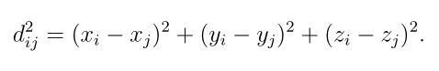
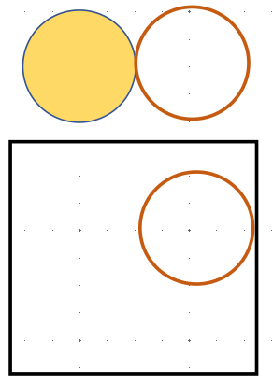
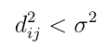
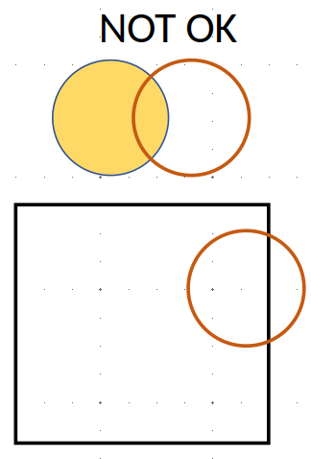
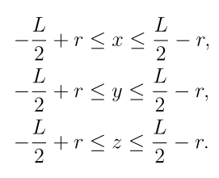
Exclude Volume
To ensure that any two particles i and j do not overlap, we compute the squared center-to-center distance
For the particles with the diameter σ, overlap is rejected by imposing the condition
dij < sigma (without square)
Notes:
Excluded volume is a key component of coarse-grained (CG) modeling, ensuring that two particles cannot occupy the same space. Without it, particles may overlap or penetrate each other, causing unphysical behavior.
To prevent particles from penetrating the membrane walls, the center of each particle is constrained to remain at least a distance a (the particle radius) away from each face of a cubic simulation box of side length L, centered at the origin. This constraint is enforced by requiring

Slide 10
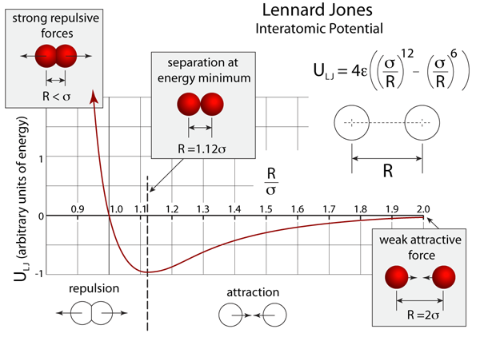
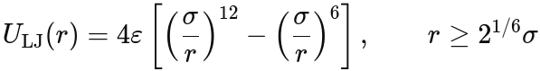
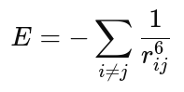
Effective Interaction Potential (Lennard–Jones)
Attraction between genome and intracelluar components
Notes:
Here I introduce the effective interaction used in the coarse-grained model. The Lennard–Jones potential includes a strong short-range repulsion that prevents particle overlap and a weaker long-range attraction that promotes compaction and cohesion. The balance between these two terms sets a preferred separation between particles.In the context of our simulations, this potential provides a minimal physical description of interparticle interactions without introducing chemical detail.
Repulsion term
When particles get very close
Represents strong short-range repulsion
Physically: particles cannot overlap
Dominates when r is small
This is the repulsive part
Attraction term
This term is negative
Represents weak attraction at longer distances
Physically: van der Waals attraction
Dominates at moderate r
👉 This is the attractive part

Slide 11
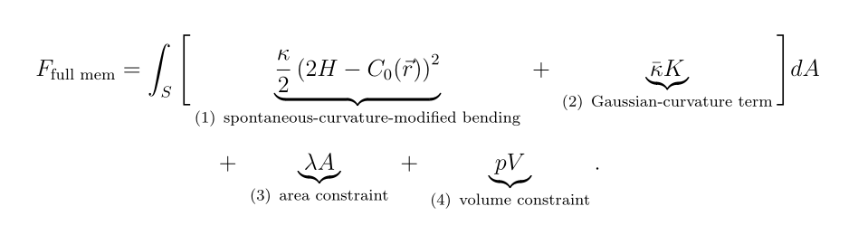
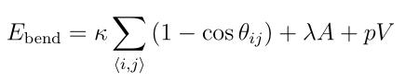
Helfrich–Canham Membrane Elasticity Model
(1)Continuum description of membrane bending energy (theoretical):
(2)Discrete angle-based formulation for simulations (practical):
where θij is the dihedral angle between neighboring triangles
Notes:
The Helfrich–Canham model describes how a membrane resists bending by assigning an energy cost when the membrane shape deviates from a preferred curvature. The bending rigidity κ determines how stiff the membrane is, while the spontaneous curvature C0 (r) represents local tendencies of the membrane to bend, for example due to asymmetry or protein binding. The Gaussian curvature term, with coefficient κ̄, remains constant as long as the membrane is closed and its topology does not change.
To maintain a physically realistic membrane, constraints on the total surface area and the enclosed volume are imposed using the parameters λ and p. These constraints prevent unphysical stretching or compression of the membrane and allow control of the internal pressure, which is important for modeling a genome confined within a membrane.
For simulations, the bending energy from the continuum membrane theory is rewritten in a more practical, discrete form using a triangulated surface. In this approach, the membrane is represented by connected triangular facets, and the local curvature is approximated by the dihedral angles between neighboring faces. This angle-based formulation is well suited for numerical implementation and enables efficient evaluation of membrane bending energy in Monte Carlo simulations, while still preserving the essential elastic behavior of the theoretical Helfrich–Canham model.

Slide 12
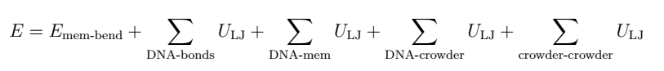
Simple Liquid Models
A simple liquid model is used to describe a system in which the total interaction energy is built by adding simple pairwise interaction potentials between particles.
Each potential represents a specific physical interaction (repulsion, attraction, bonding, confinement), and the total energy is written as a sum of these contributions.
Notes:
Simple liquid models are idealized physical models used to describe the behavior of particles interacting through minimal, generic forces. These models capture essential features of liquids—such as excluded volume, attraction, and packing—without including chemical or molecular details. In this work,
we employ the hard-sphere model and the Lennard–Jones model as simple liquid descriptions. The hard-sphere model represents particles as impenetrable spheres and is used to study systems where excluded-volume effects dominate, such as crowded environments and dense suspensions.
The Lennard–Jones model includes both short-range repulsive and longer-range attractive interactions between particles. It provides a simple yet effective description of non-ideal fluids and condensed matter systems, where intermolecular attraction plays an important role. In coarse-grained simulations, this model is widely used to represent effective interactions between particles in crowded environments.

Slide 13
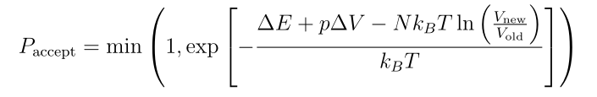
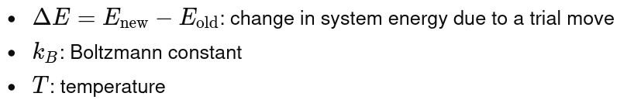
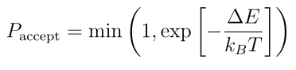
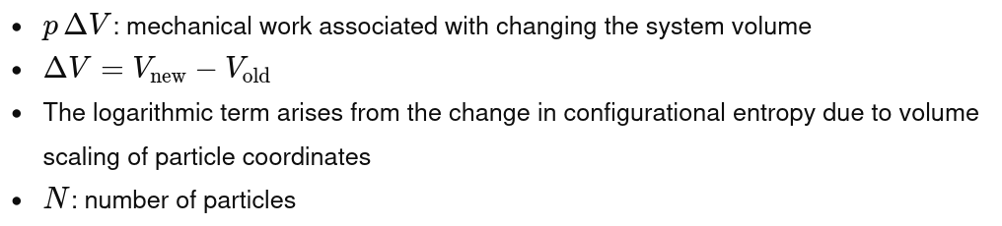
Monte Carlo Acceptance Criteria in NVT and NPT Ensembles
NPT ensemble (constant N,P,TN, P, TN,P,T)
NVT ensemble (constant N,V,TN, V, TN,V,T)
Notes:
NPT
This acceptance rule ensures proper sampling of the isothermal–isobaric ensemble, allowing both particle moves and volume fluctuations consistent with the imposed pressure.
NVT
Moves that lower the energy (ΔE<0\Delta E < 0ΔE<0) are always accepted, while higher-energy moves are accepted with a probability that decreases exponentially with ΔE\Delta EΔE. This allows thermal fluctuations while favoring low-energy configurations.
Key difference between NVT and NPT
NVT: acceptance depends only on energy changes
NPT: acceptance includes energy, volume work, and entropic contributions

Slide 14
Hypothesis
You have mixed the real questions you want to solve and simulation models.
(1)Virus shape and genome structure develop through interactions where either the genome or
membrane stabilizes first, or both stabilize together. Changing genome length or shape lets the model reproduce these behaviors and match experiments.
(2)If a genome-like rod and crowder particles are confined inside an initially cubic, flexible
membrane/box, then after equilibrating the internal packing in NVT and subsequently allowing
box-shape fluctuations in NPT, the system will spontaneously break cubic symmetry and evolve toward an elongated cuboid (rectangular-prism) equilibrium shape.
For example:
Morphologies of a viral genome dictate the shape of a virus. Mutual interactions among genome, interior materials, and membranes are essential.
(2) A virus may start with a more spherical shape and evolves into different shapes along with the transition of a genome into its mature geometry.
Are these points what you want talk about?
Your proposed model studies should be in line with these hypotheses. (Change your written proposal as well.)

Slide 15
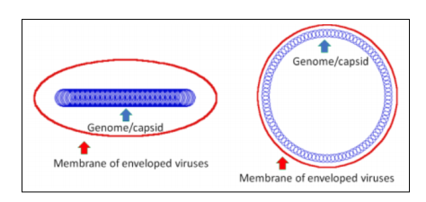
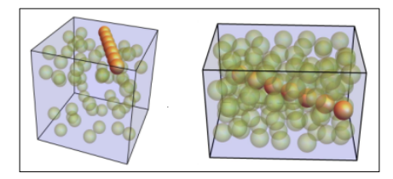
Expected result
Preliminary studies, not expected results
Preliminary 2D model studies to investigate the effect of the geometry of a genome on the shape of a virus. A rod-like genome induces an elliptic shape whereas a circular genome leads to a circular shape
Initial cubic configuration (left) and final elongated cuboid configuration (right) obtained after sequential NVT equilibration followed by NPT simulation, consistent with the morphology of Monkeypox (Orthopoxvirus) particles.
Notes:
In terms of genomes, Orthopoxviruses are DNA viruses containing about 200 kilobase pairs of double-stranded DNA on average, forming a rigid, elongated dumbbell morphology with a contour size of about 250 nm in length and 200 nm in width. Coronaviruses,by contrast, are single-stranded RNA viruses with around 30 kilobase pairs and an average contour size of 50–
140 nm. A general feature among these viruses is that their genomes are highly confined and crowded insidethe capsid. As a result, they may exhibit internal pressures ranging between 10–60 atm to facilitate genome injection into the host cell’s nucleus.

Slide 16
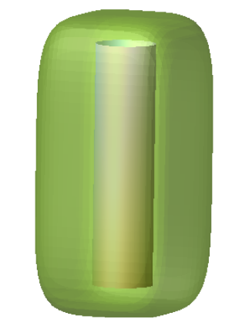
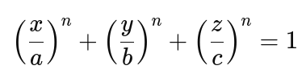
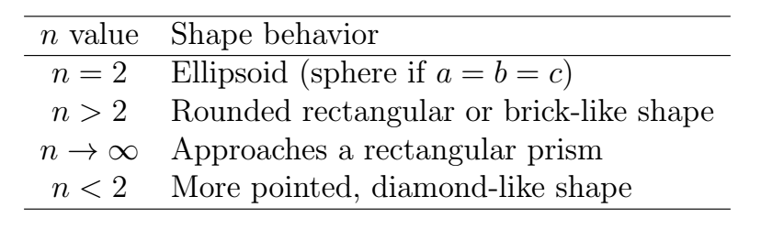
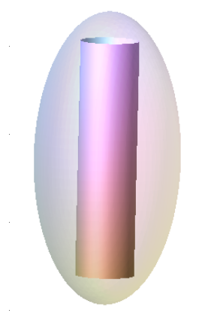
Superellipsoid
A super-ellipsoid is a smooth 3D shape defined by the equation
It generalizes simple shapes by changing one parameter n.
a,b,c: Control the size along the three axes→ long, flat, or brick-like shapes
n(shape parameter):Controls how rounded or box-like the surface
Notes:
The parameters a b,c set the size along each axis, determining whether the shape is elongated, flattened, or brick-like. a,b,c control the overall dimensions and aspect ratios n(shape parameter):Controls how rounded or box-like the surface n controls the roundness of the surface and edge sharpness
We use the superellipsoid model because it gives a smooth and flexible way to describe virus shape. By changing the parameters a b c, we control the overall size and aspect ratios, and by changing n, we control how rounded or box-like the surface is. This allows us to represent realistic virus shapes while keeping the curvature well defined, which is important for calculating membrane bending energy.

Slide 17
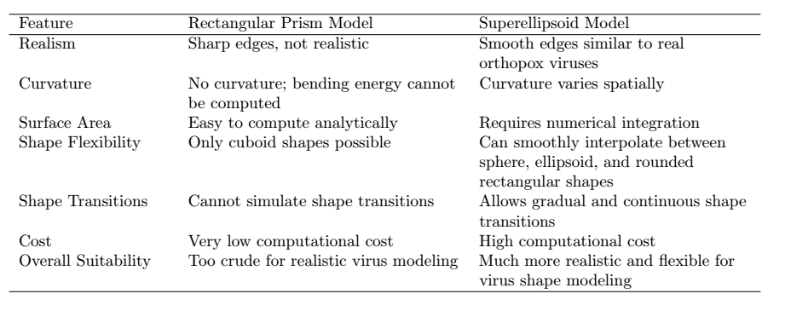
Superellipoid
less
It can only study cube to rectangle transition.
How low is “very low”?
Less realistic
Higher (since you never done any calculations, you won’t be able to answer the question regarding how much computational cost needed.
Avoid strong wordings since you have no quantitative information in any of these models

Slide 18
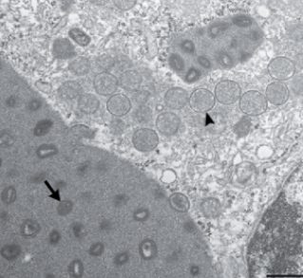
Expected result
The Superellipsoid model helps explain:
Why
COVID-19 virus particle stays more spherical
Monkeypox virus particle becomes dumbbell-shaped
How:
Crowding + container curvature reshape genome packing
Why:
Immature viruses are round
Mature orthopoxviruses are brick-like
Spacing between text and figure
The upper box in Panel A at a higher magnification. Type A viral inclusion bodies, which are observed in infections caused by some orthopoxvirus species, are composed of proteinaceous material and mature virus particles (arrow). Type B viral inclusion bodies, also known as viral factories, are composed of spherical, immature virus particles (arrowhead).

Slide 19
Timeline
Work 1:
Genome Geometry–Driven Membrane Deformation. Establish how genome length, stiffness, and
geometry control membrane shape under confinement.
(1)Develop a coarse-grained bead–spring genome model confined within a flexible Helfrich–Canham
membrane.
(2)Systematically vary:
(i)genome length (short RNA vs long DNA)
(ii)genome stiffness (flexible vs rod-like)
(iii)membrane size and bending rigidity
Work 2:
This work will examine how internal pressure affects the size and geometry of a virus, and how
weak attractions between the genome and the surrounding cellular environment influence host cell
membrane after host-cell entry. A simple coarse-grained model with Lennard-Jones attractions will be
used, in which genome length, stiffness, and interaction strength are varied to observe how virus shape
and genome position respond.
Work 3:
Shape Symmetry Breaking Explain why COVID-19 virus particle stays more spherical and Monkeypox virus particle more dumbbell-shaped and why some viruses (e.g., Monkeypox) transition from spherical to elongated shapes,
* Work 1, 2 and 3 change to Goal 1, 2, and 3
* Since you have shown no any significant progress so far, it will be too challenging for you to start your studies from “wok 1”.
*You may combine “Develop a coarse-grained … “ with “Work 2” on this page as Goal 1.

Slide 20
Reference
[1] Zhenhao Ke, Jose Oton, Kun Qu, Marcella Cortese, Vedran Zila, Liam McKeane, Takanori Nakane, Jasenko Zivanov, Christopher J Neufeldt, Bastian Cerikan, Jianmin M Lu, Julian Peukes, Xiaoli Xiong, Hans-Georg Kräusslich, Sjors H. W. Scheres, Ralf Bartenschlager, and John A. G. Briggs. Structures and distributions of sars-cov-2 spike proteins on intact virions. Nature, 588(7838):498–502, December 2020. Epub 2020 Aug 17.
[2] Centers for Disease Control and Prevention (CDC). Sars-cov-2 illustration. https://www.cdc.gov/museum/timeline/covid19.html, n.d. Accessed April 18, 2025.
[3] Naoki Nakatani, Hiroshi Sakuta, Makoto Hayashi, Shunsuke Tanaka, Kohei Takiguchi, Kouhei Tsumoto, and Kenichi Yoshikawa. Specific spatial localization of actin and dna in a water/water microdroplet: Self-emergence of a cell-like structure. Chembiochem, 19(13):1370–1374, 2018.
[4] Nir Erez, Hagit Achdout, Einat Milrot, Yaron Schwartz, Yonit Wiener-Well, Nir Paran, Boaz Politi, Haim Tamir, Tomer Israely, Sharon Weiss, Adi Beth-Din, Orli Shifman, Ohad Israeli, Shmuel Yitzhaki, Shaul C Shapira, Shay Melamed, and Eli Schwartz. Diagnosis of imported monkeypox, israel, 2018. Emerging Infectious Diseases, 25(5):980–983, May 2019.
[5] Shane Parker, Andrea Nuara, R Mark Buller, and David A Schultz. Human monkeypox: an emerging zoonotic disease. Future Microbiology, 2(1):17–34, Feb 2007.

Slide 21
Reference
[6] Cynthia S Goldsmith and Russell Regnery. Monkeypox virus particle. Public Health Image Library, Centers for Disease Control and Prevention, 2003. Image ID: 22664.
[7] Yinon M Bar-On, Avi Flamholz, Rob Phillips, and Ron Milo. Sars-cov-2 (covid-19) by the numbers. Elife, 9:e57309, Apr 2020.
[8] Lei Wu, Wenhui Zhou, Lihua Lin, Anhong Chen, Jing Feng, Xiangmeng Qu, Hongbo Zhang, and Jun Yue. Delivery of therapeutic oligonucleotides in nanoscale. Bioactive Materials, 7:292–323, 2022.
[9] Emily Barrow, Anthony V. Nicola, and Jun Liu. Multiscale perspectives of virus entry via endocytosis. Virology Journal, 10:177, 2013.
[10] Susan Payne. Viruses: From Understanding to Investigation. Elsevier, 2nd edition, 2022.
[11] A. Brandariz-Nuñez, T. Liu, T. Du, and A. Evilevitch. Pressure-driven release of viral genome into a
host nucleus is a mechanism leading to herpes infection. eLife, 8:e47212, 2019.
[12] Morgan Chabanon, Jeanne C. Stachowiak, and Padmini Rangamani. Systems biology of cellular
membranes: a convergence with biophysics. Wiley Interdisciplinary Reviews: Systems Biology and
Medicine, 9(5), sep 2017. Epub 2017 May 5.

Slide 22
Reference
[13] Paul Grayson, Alex Evilevitch, Mandar M. Inamdar, Prashant K. Purohit, William M. Gelbart,
Charles M. Knobler, and Rob Phillips. The effect of genome length on ejection forces in bacteriophage
lambda. Virology, 348(2):430–436, 2006.
[14] Horst L. Vörtler and Matthias Kettler. Monte carlo simulation of pore systems: primitive model of
water in slit-like pores. Chemical Physics Letters, 266(3–4):368–374, 1997.

Slide 23
Thank you!

Slide 24
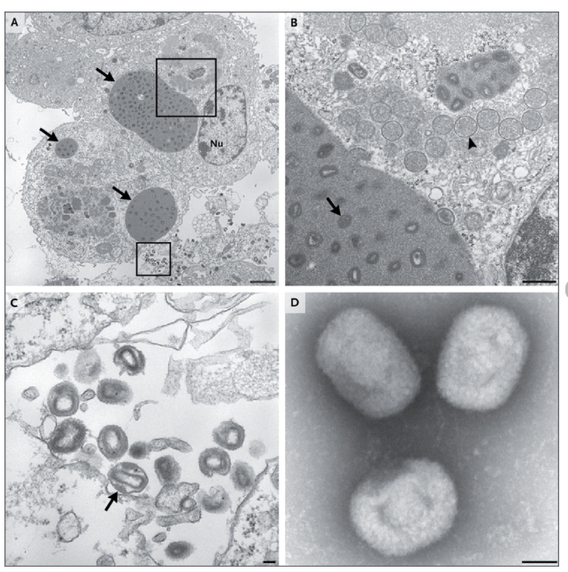
The Novel Orthopoxvirus on Transmission Electron Microscopy. Thin-section electron microscopy and negative-stain electron microscopy were performed, as previously described . 20,21 Panel A shows type A viral inclusion bodies (arrows) in infected cell-culture cells on thin-section electron microscopy. Nu denotes the cell nucleus. The scale bar represents 2 μm. Panel B shows the area in the upper box in Panel A at a higher magnification. Type A viral inclusion bodies, which are observed in infections caused by some orthopoxvirus species, are composed of proteinaceous material and mature virus particles (arrow). Type B viral inclusion bodies, also known as viral factories, are composed of spherical, immature virus particles (arrowhead). The scale bar represents 500 nm. Panel C shows a higher magnification of the extracellular mature virions shown in the area in the lower box in Panel A. A lateral body within a maturing virus particle (arrow) is shown. The scale bar represents 100 nm. Panel D shows brick-shaped virions, with short, whirled filaments on the surface on negativestain electron microscopy. The scale bar represents 100 nm.
Vora, Neil & Li, Yu & Geleishvili, Marika & Emerson, Ginny & Khmaladze, Ekaterine & Maghlakelidze, Giorgi & Navdarashvili, Archil & Zakhashvili, Khatuna & Kokhreidze, Maka & Endeladze, Marina & Mokverashvili, Gela & Satheshkumar, P.S. & Gallardo-Romero, Nadia & Goldsmith, Cynthia & Metcalfe, Maureen & Damon, Inger & Maes, Edmond & Reynolds, Mary & Morgan, Juliette & Carroll, Ph.D.. (2015). Human Infection with a Zoonotic Orthopoxvirus in the Country of Georgia. New England Journal of Medicine. 372. 10.1056/NEJMoa1407647.

